Slide 1


Bapuji Educational Association(R) BAPUJI INSTITUTE OF ENGINEERING AND TECHNOLOGY Department of Electronics and Communication Engineering 2025-26 Phase 2 Project Work Final Presentation IoT Based School Bus Management Using RFID Project associates
Anuradha P 4BD22EC011
Sanjay S Sheshagiri 4BD22EC079
Shubhashree B M 4BD22EC121
Dr. Kiran Kumar G H
M.Tech., Ph.D.
Project Guide
Dr. G. S. Sunitha
M. Tech.(DEAC), Ph.D., MISTE, FIETE, FIE
Program Coordinator

Slide 2
Vision of Department
“To be in the fore front of providing quality technical education and research in Electronics & Communication Engineering to produce skilled professionals to cater to the challenges of the society.”
Mission of Department
M1. To facilitate the students with profound technical knowledge through effective teaching learning process for a successful career.
M2. To impart quality education to strengthen students to meet the industry standards and face confidently the challenges in the programme.
M3. To develop the essence of innovation and research among students and faculty by providing infrastructure and a conducive environment.
M4.To inculcate the student community with ethical values, communication skills, leadership qualities, entrepreneurial skills, and lifelong learning to meet the societal needs

Slide 3
Course Objectives:
This course will enable students to
Develop skills of identifying, analyzing and proposing a work plan to solve anengineering problem.
Enhance ability of exploring the literature and existing products, carry out field visits,technical presentation and report preparation.
Estimate resources required, and make plans to utilize the necessary resources.
Develop interpersonal relations in team work.
Course Outcomes:
On completion of this course, students are able to
Identify and propose plan to solve the engineering problems in the society.
Extensively explore the literature and products available in the area of identified problem
Have knowledge of available resources and their utilization.
Work effectively in teams and demonstrate team-building capabilities.

Slide 4
FLOW OF PRESENTATION
INTRODUCTION
LITERATURE SURVEY
PROBLEM STATEMENT
OBJECTIVES
BLOCK DIAGRAM & METHODOLOGY
FLOWCHART
CIRCUIT DIAGRAM
HARDWARE & SOFTWARE DESCRIPTION
APPLICATIONS
LIMITATIONS
RESULTS
CONCLUSION
REFERENCES

Slide 5
INTRODUCTION
In recent years, the integration of smart technologies into transportation systems has transformed the way we approach safety, efficiency, and convenience.
Traditional school bus systems lack real-time tracking, unauthorized access, and automated safety mechanisms like during boarding and alighting.
In this system, each student is issued an RFID card, which is scanned while boarding the bus. The RFID data is processed by the ESP WROOM 32 microcontroller, which authenticates the student and updates their boarding status to the cloud in real-time.
The system integrates a GPS module for live location tracking, a solenoid lock for automatic door control, and IoT connectivity for continuous monitoring by parents and school authorities.
Additionally, LCD displays, buzzer alerts, and LED indicators enhance the safety and interactivity of the system.

Slide 6
Literature Survey
SI.No | Ref. Paper authors / year | Objectives / Issues addressed | Parameter Evaluated | Adaptive Technique | Drawbacks | Open issue / Improvements
1. | Dr. Deepika Rani Sona et al., 2024 | Designed an IoT-enabled school bus monitoring system for real-time student attendance, location tracking, and emergency alerting to parents. | Accuracy of attendance logs, live GPS tracking, emergency SMS reliability. | Integration of RFID for ID verification, GPS for tracking, GSM for alerts, and GPRS for cloud sync via ThingSpeak. | Prototype not miniaturized, lacks predictive intelligence like ETA. | Introduce AI for ETA, driver fatigue monitoring, and mini-IC-based hardware for practical deployment.
2. | Nayana Shaji et al., 2023 | Developed a digital bus ticketing system using RFID and GPS to automate fare based on distance and log travel data in a central system. | Trip distance via GPS, fare deduction logs, RFID card authentication. | RFID-enabled college ID with NFC, GPS-based fare calculator, NodeMCU controller, and Android interface. | Focuses more on payment than safety; lacks boarding alerts to parents. | Integrate secure payments (e.g., UPI), real-time notifications to parents, and student safety features.

Slide 7
SI. No | Ref. Paper authors / year | Objectives / Issues addressed | Parameter Evaluated | Adaptive Technique | Drawbacks | Open issue / Improvements
3. | B. Nithin et al., 2022 | Proposed a comprehensive school bus monitoring system for student tracking, route monitoring, and parental notifications using GPS and cloud. | Real-time GPS feed, student entry/exit timestamps, message alerts. | RFID with Wi-Fi cloud sync, GPS tracking, Arduino microcontroller, mobile app for live access. | Wi-Fi-only data transfer can limit range; RFID tags can be lost or forgotten. | Improve with biometric verification, offline sync fallback, and automated route change alerts.
4. | M. Malleswari et al., 2018 | Implemented a basic RFID-based college bus system that logs student details and location at a central base station via GSM and GPS. | RFID logging, GPS-based location, data transmission via GSM to a local server. | GSM for data transfer, GPS for vehicle location, RFID for student validation; database logging via microcontroller. | No mobile/cloud access, outdated notification system,lacks interface for parents. | Upgrade to IoT cloud-based model, include app integration and smart dashboard analytics for admin.

Slide 8
Problem Statement
In conventional school bus systems, there is no real-time student tracking, making it difficult for parents and schools to ensure safety during transit. Manually checking student presence is time-consuming and lacks reliability. Additionally, the lack of an authentication mechanism allows unauthorized access, posing serious security risks.

Slide 9
Objectives
To develop a smart school bus management system that ensures student security using RFID authentication, real-time GPS tracking, automated door locking, and IoT integration for monitoring.
To provide a user-friendly interface for parents and school administrators to monitor bus location and student entry logs.

Slide 10
Block Diagram
LCD 16X2
LED,
Buzzer
IoT cloud
ESP WROOM 32
GPS Neo 6M
Relay
RFID Scanner
Solenoid Lock
12V Power Supply

Slide 11
Methodology
The IoT-based school bus management system begins with each student scanning their RFID card while boarding the bus.
The RFID scanner reads the card data and sends it to the ESP WROOM 32 microcontroller for verification. Once authenticated, the ESP WROOM 32 activates the relay to unlock the solenoid lock, allowing the student to enter.
Simultaneously, the GPS module captures the live location of the bus, and all data—student ID, time of entry, and location—is uploaded to the IoT cloud platform for remote monitoring.
The system also triggers a buzzer and LED for safety alerts, while an LCD display shows real-time authentication results. This method ensures a secure, automated, and trackable transportation system.

Slide 12
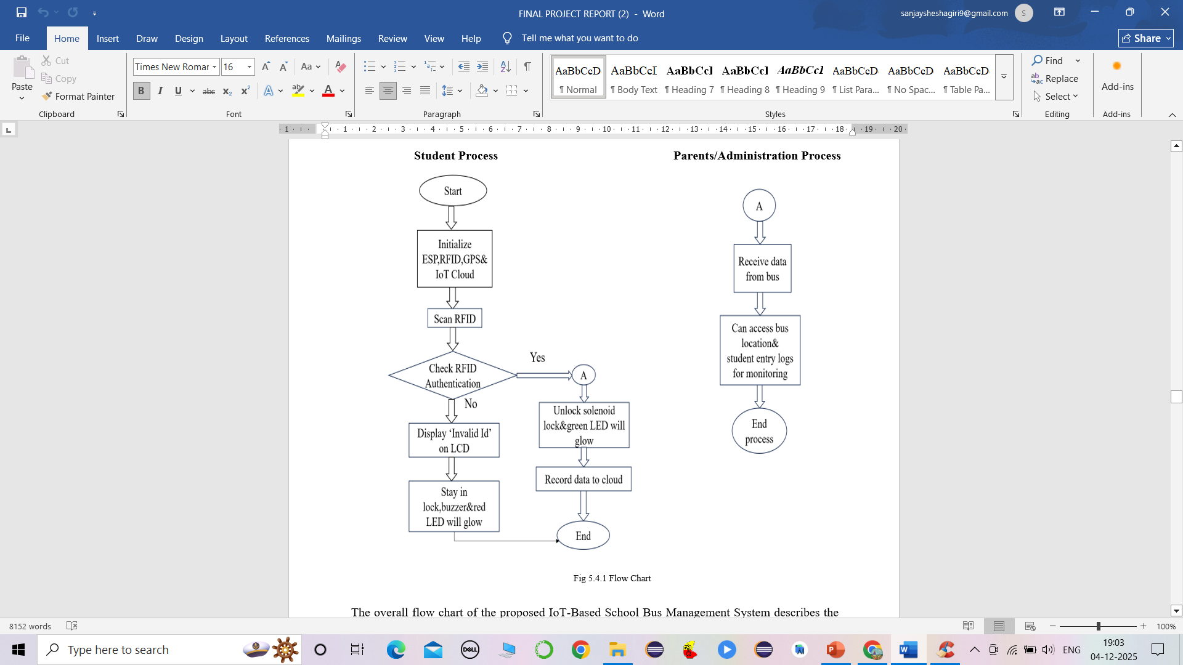
Flow Chart

Slide 13
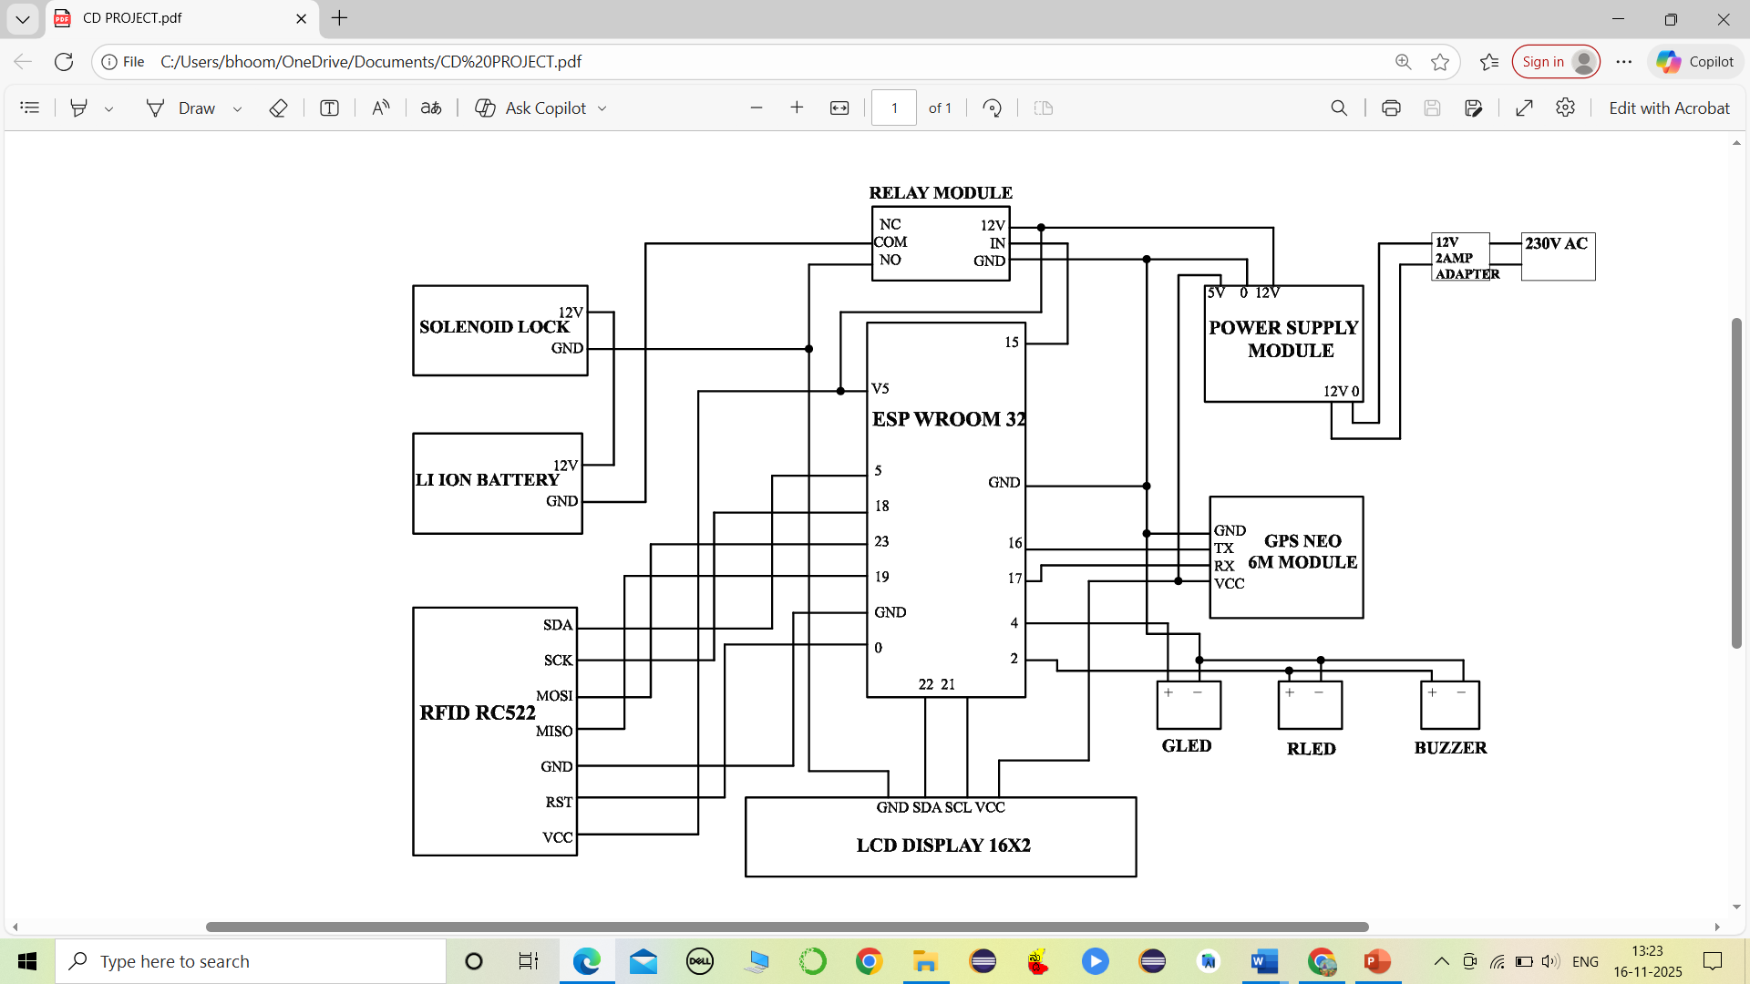
Circuit Diagram

Slide 14
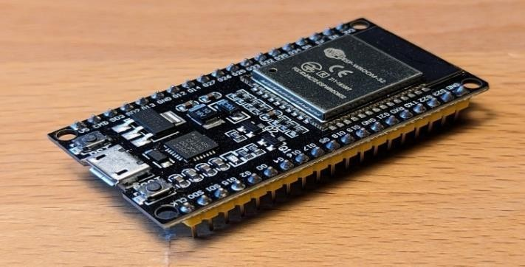
Hardware Requirements
1.ESPWROOM 32
Role-Central microcontroller that controls, processes, and manages communication between all modules.
Explanation-The ESP WROOM 32 is a powerful Wi-Fi and Bluetooth-enabled microcontroller used to process RFID data, control outputs like solenoid locks, and communicate with cloud services. It receives input from the RFID, GPS, and sensors, processes it, and triggers appropriate outputs including locking/unlocking doors, displaying messages, and sending cloud updates.
Specifications-
Dual-core Xtensa 32-bit LX6 microprocessor
Clock speed: up to 240 MHz
Flash Memory: 4 MB
GPIO Pins: 34
Wi-Fi & Bluetooth enabled & Operating Voltage: 3.3V

Slide 15
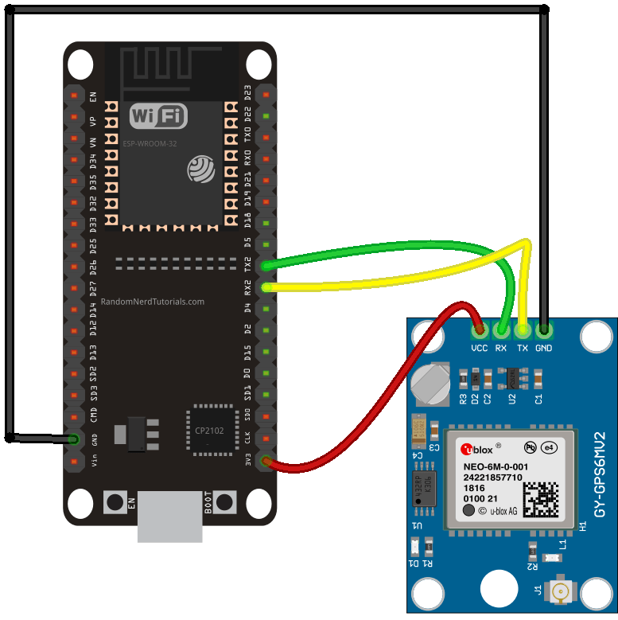
2.GPS Neo 6M
Role-Provides real-time geographic location of the bus.
Explanation-The Neo-6M GPS module receives satellite signals to determine accurate latitude and longitude coordinates. It sends this data to the ESP WROOM 32 for live tracking and cloud uploading.
Specifications
Operating Voltage: 3V to 5V
GPS Baud Rate: 9600
Position Accuracy: 2.5 meters
Cold Start Time: 38 s

Slide 16
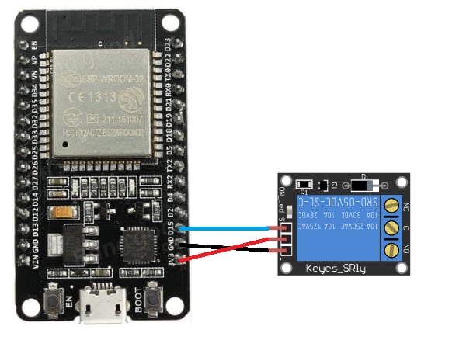
3.Relay Module
Role-Acts as an electronic switch to control the solenoid lock.
Explanation-The relay module receives control signals from the ESP WROOM 32 and turns ON/OFF high-voltage components like the solenoid lock or buzzer system.
Specifications
Operating Voltage: 5V
Trigger Current: 5mA
Number of Channels: 1

Slide 17
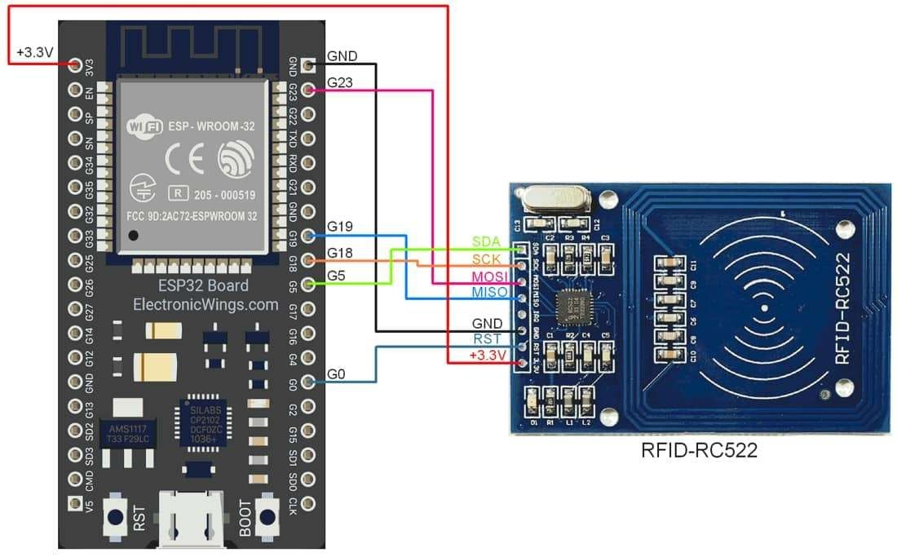
4.RC522 RFID Module
Role-Reads student RFID cards for authentication.
Explanation-The RC522 module scans RFID tags/cards presented by students. It sends the unique ID to the ESP WROOM 32, which verifies it against valid rfid tags.
Specifications
Operating Frequency: 13.56 MHz
Communication Interface: SPI
Operating Voltage: 3.3V
Reading Distance: 2–5 cm

Slide 18
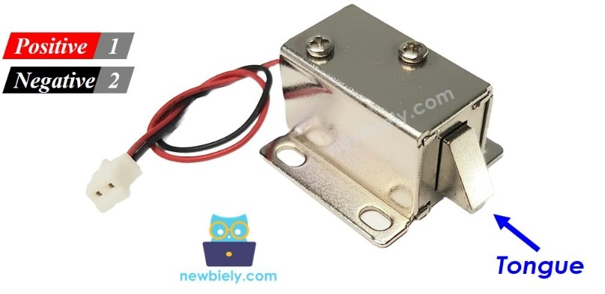
5.Solenoid Lock
Role-The solenoid lock is used to automatically lock and unlock the bus door based on RFID authentication, ensuring only authorized students can enter.
Explanation-The ESP32 activates the solenoid lock through a relay when a valid RFID card is scanned, allowing the door to open. For invalid cards, the solenoid remains de-energized, keeping the door securely locked and preventing unauthorized entry.
Specifications
Operating Voltage: 12V DC
Type: Electromagnetic plunger lock
Operation: Normally closed (opens when energized)

Slide 19
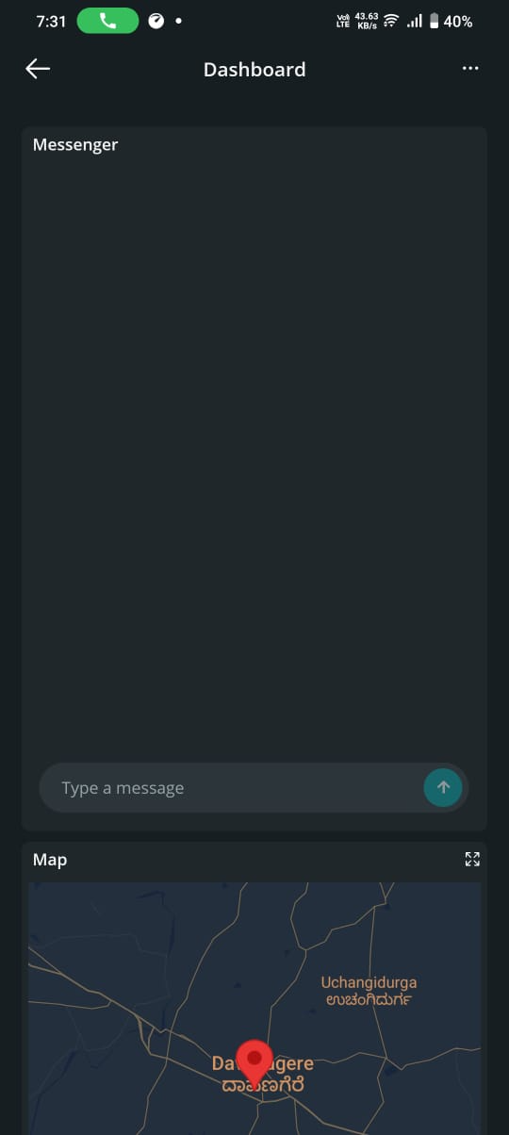
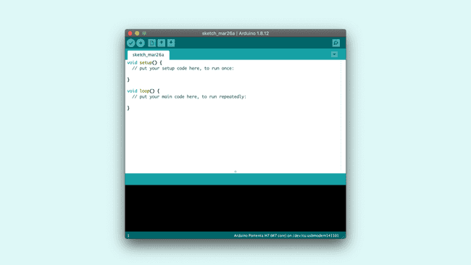
SOFTWARE REQUIREMENTS
1.Arduino IDE:
The Arduino Integrated Development Environment (IDE) is used to write, debug, and upload the code to the Arduino Uno.
The IDE supports C and C++ languages, which are required to develop the control logic for the system.
2.Arduino IoT Cloud Platform:
The Arduino IoT Cloud is an online platform that enables seamless communication between IoT devices and users through the internet. It is designed to allow remote monitoring, data visualization, and device control.

Slide 20
Applications
Student Safety and Security:Only authorized students can board the bus using RFID authentication, ensuring protection against unauthorized access.
Real-Time Tracking:The GPS and Arduino IoT Cloud enable live bus location tracking for parents and school authorities.
Parental Monitoring and Alerts:Parents can monitor the bus’s location and get updates on their child’s boarding status in real time.
Efficient School Transport Management:Helps school administrators optimize routes, monitor timings, and ensure safe transportation.
Scalable Smart Transport System:The same concept can be extended to college buses, corporate fleets, or public transport for better automation.

Slide 21
Limitations
Internet Dependency:The system relies on a stable internet connection for real-time data upload to the Arduino IoT Cloud. Poor network coverage can cause delayed updates.
RFID Card Misuse:Since the system lacks biometric or facial recognition, anyone carrying a student’s RFID card could misuse it to gain unauthorized access.
Initial Cost and Scalability:Setting up multiple buses requires more devices and cloud subscriptions, increasing initial implementation cost.

Slide 22
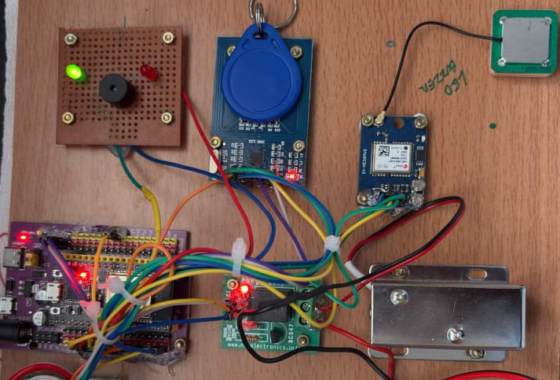
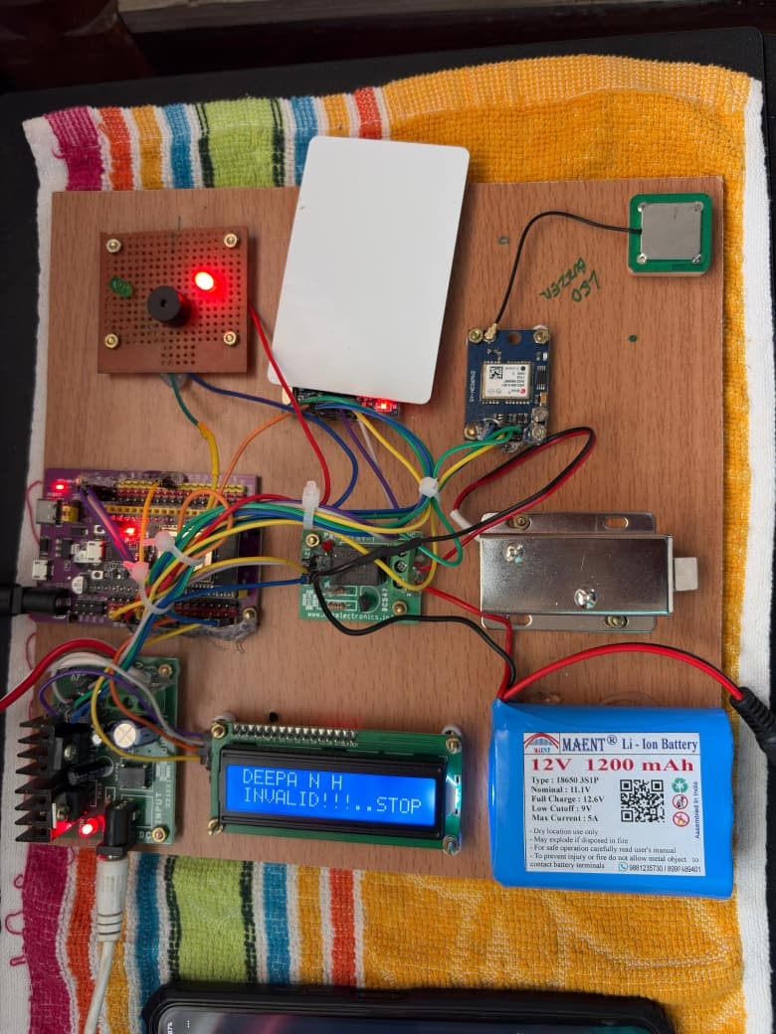
Result & Reflection
When a valid RFID card is scanned, the system instantly authenticates the student and activates the relay to open the solenoid lock as shown in 1st picture. The green LED glows to indicate successful entry, and after a few seconds the door automatically closes, ensuring controlled access.
If an unauthorized or invalid RFID card is scanned as shown in 2nd picture, the system rejects the entry and keeps the solenoid lock closed. The red LED turns ON and the buzzer sounds to alert about the invalid attempt, preventing unauthorized boarding.

Slide 23
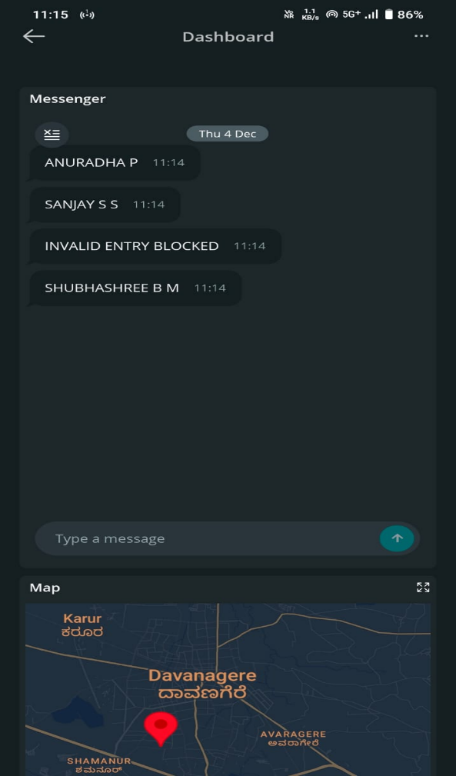
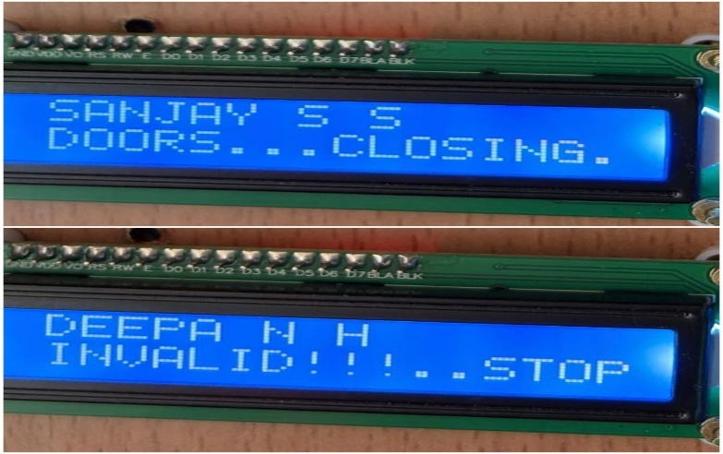
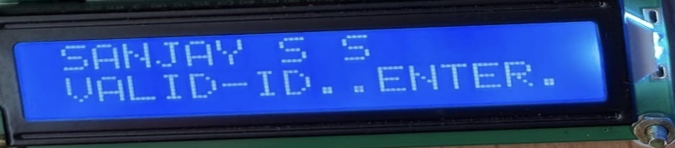
The LCD accurately displays the authentication status of each scanned RFID card. For a valid ID, it shows the student’s name along with messages like “VALID-ID..ENTER” and “DOORS…CLOSING”, indicating successful access and automatic door operation. For an invalid ID, the LCD clearly alerts with “INVALID!!!..STOP”, preventing access and triggering safety alerts.
The Arduino IoT Cloud dashboard displays real-time student entry logs along with the live GPS location of the bus. This allows parents and school authorities to continuously monitor the bus movement and verify each authentication securely.

Slide 24
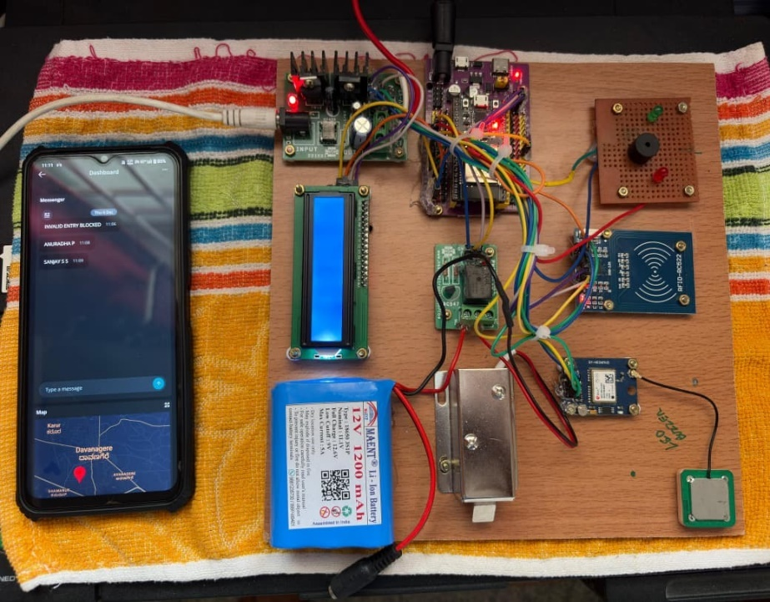
The integration of RFID authentication, GPS tracking, and IoT Cloud connectivity created a complete and reliable safety ecosystem for school bus operations. The prototype effectively prevented unauthorized entry while offering real-time bus location visibility to parents and administrators, improving transparency and trust. With ESP32 handling multiple tasks efficiently, the system proved highly responsive, scalable, and suitable for deployment in real-world school transportation environments.
Project Model

Slide 25
Conclusion
The system successfully enhances school bus safety by integrating RFID authentication, GPS tracking, and IoT cloud monitoring into a single, reliable solution.
Unauthorized access is effectively prevented, and real-time bus location updates ensure transparency for parents and school authorities.
The prototype proved efficient, accurate, and scalable, making it suitable for implementation in real-world school transportation systems.

Slide 26
REFERENCES
[1] D. R. S. Sona and S. Deepika, “IoT-Based Smart School Bus Monitoring and Notification System,” International Journal of Innovative Science and Advanced Technology (IJISAE), vol. 2, no. 6, pp. 311–316, 2024.
[2] G. D. Asha and S. R. Shinde, “Digitalization of College Bus Transportation System,” International Journal of Engineering Research & Technology (IJERT), 2023.
[3] A. S. Sharma and D. S. Shelke, “IoT Based Real Time School Bus Tracking and Monitoring,” Journal of Emerging Technologies and Innovative Research (JETIR), vol. 9, no. 7, pp. 1492–1496, July 2022.
[4] R. M. Patil and A. A. Talikoti, “IoT Based School Bus Monitoring and Notification System,” International Research Journal of Engineering and Technology (IRJET), vol. 5, no. 3, pp. 1838–1842, Mar. 2018.

Slide 27
THANK YOU

